Slide 1

𝗔𝘇𝘂𝗿𝗲 𝗗𝗮𝘁𝗮 𝗙𝗮𝗰𝘁𝗼𝗿𝘆 (𝗔𝗗𝗙) 𝗵𝗮𝗻𝗱𝘀-𝗼𝗻 𝘀𝗲𝘀𝘀𝗶𝗼𝗻
Girald Bacongan

Slide 2
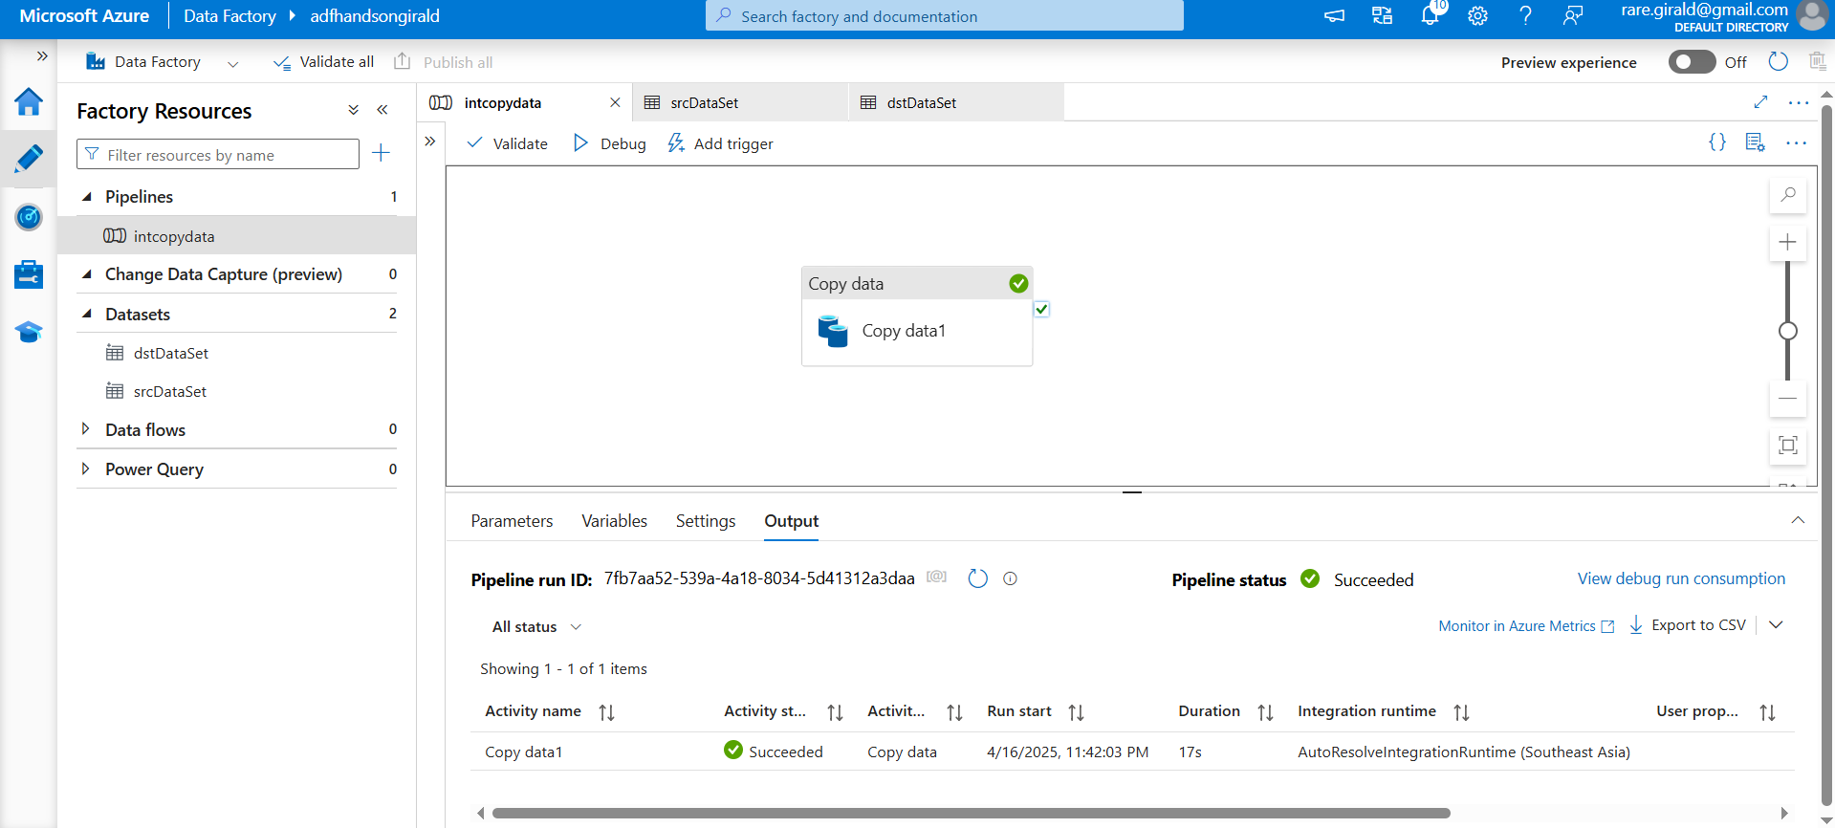
Copy data of Raw File from Source to Destination.

Slide 3
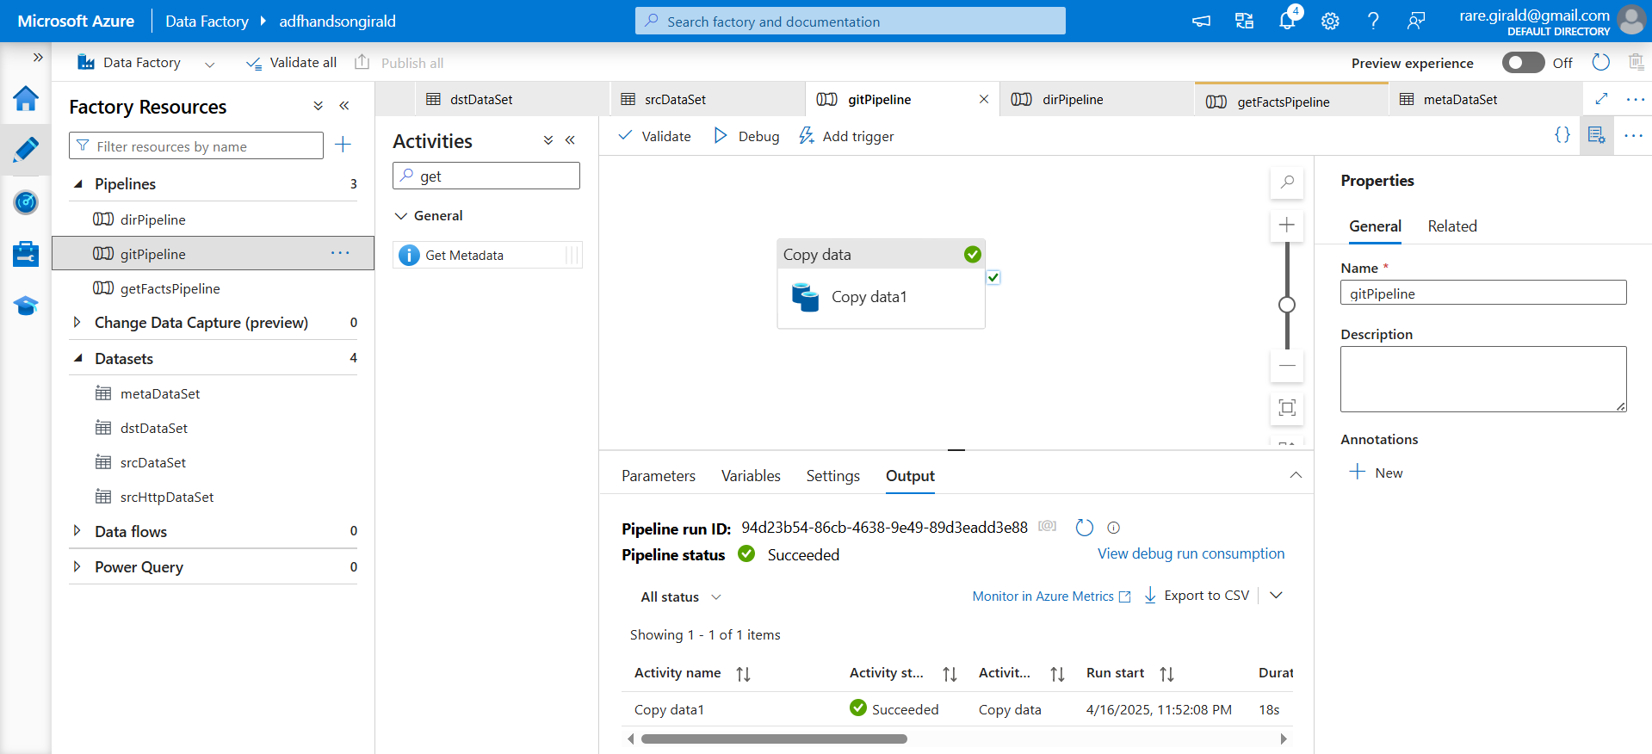
Copy Data from HTTP Source to Data Lake Destination.

Slide 4
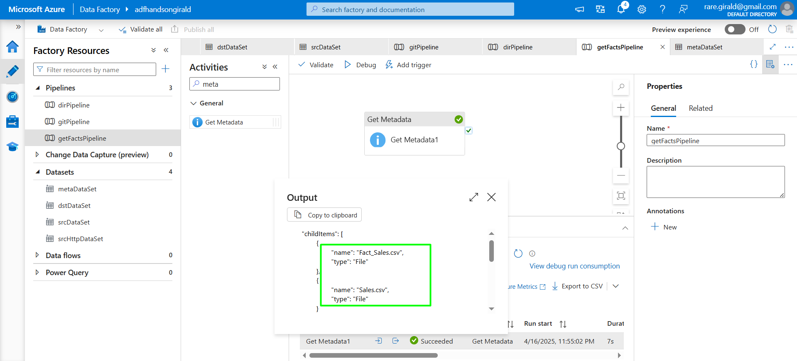
Validation of filename using get metada

Slide 5
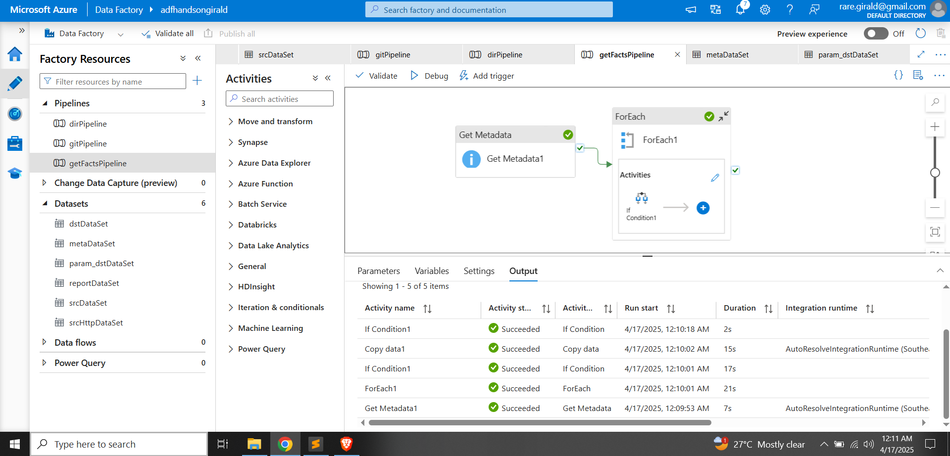
Using forEach and an if condition to retrieve the sales facts

Slide 6
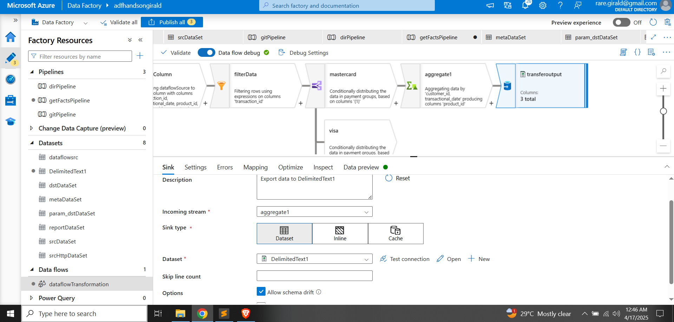
Using dataflows to transform the data

Slide 7
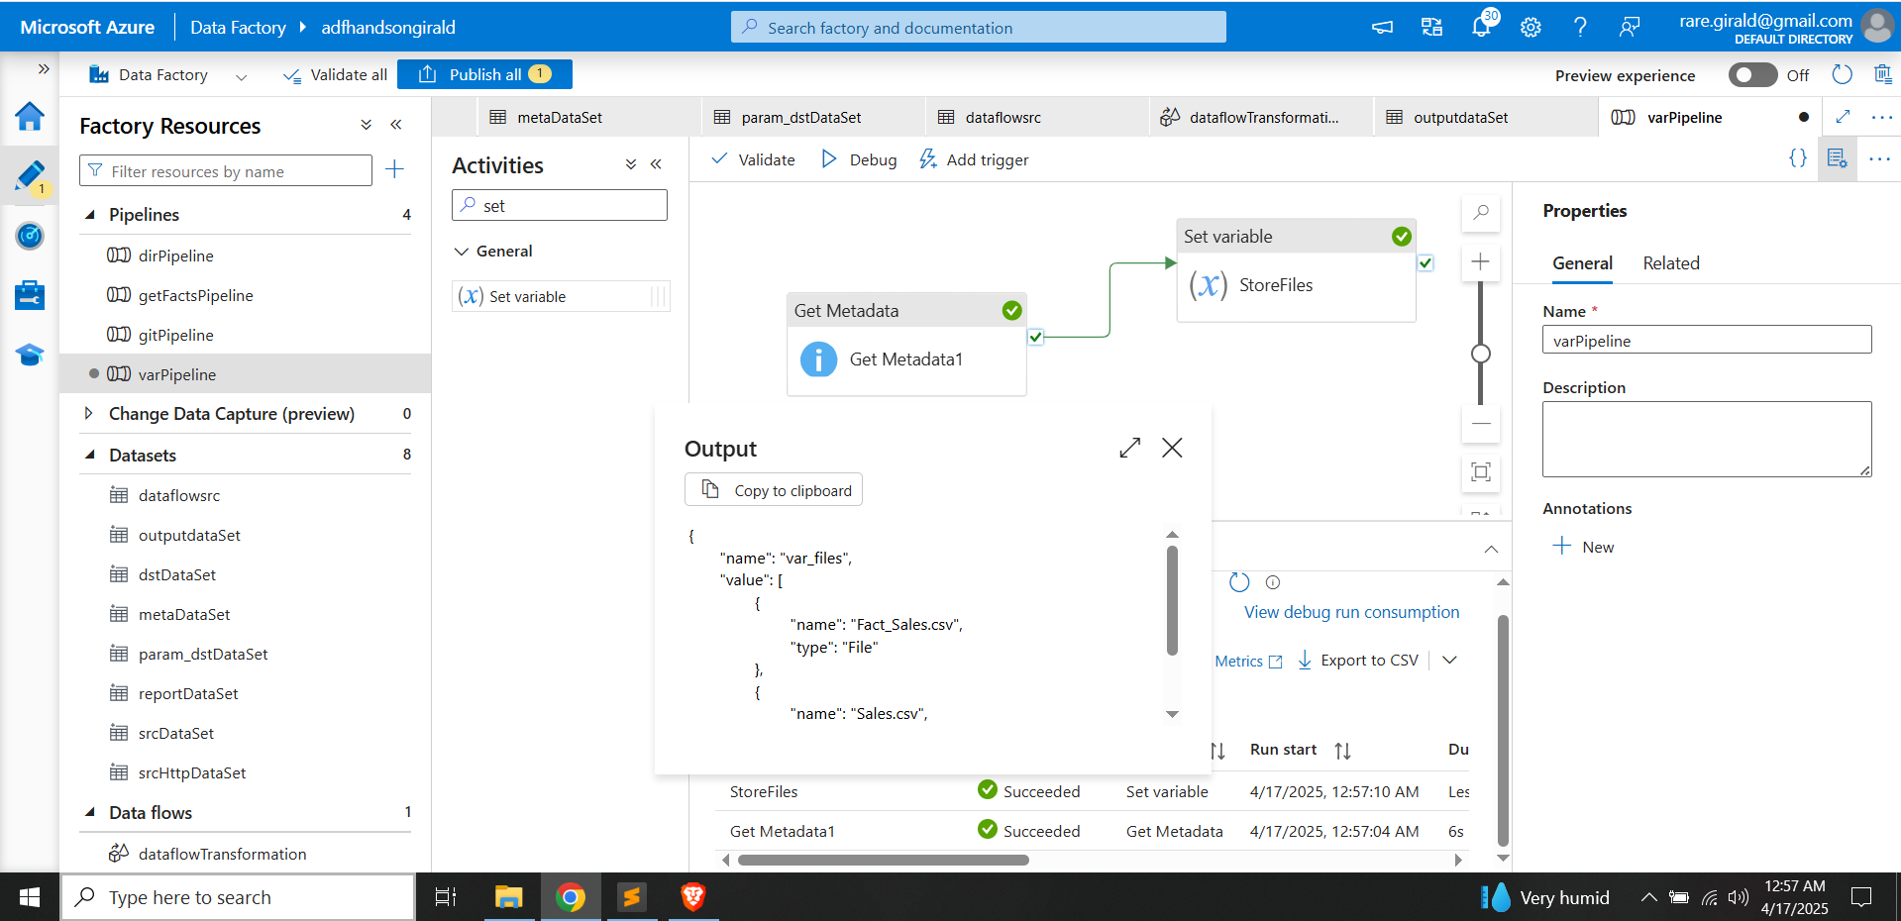
Use case of set variable

Slide 8
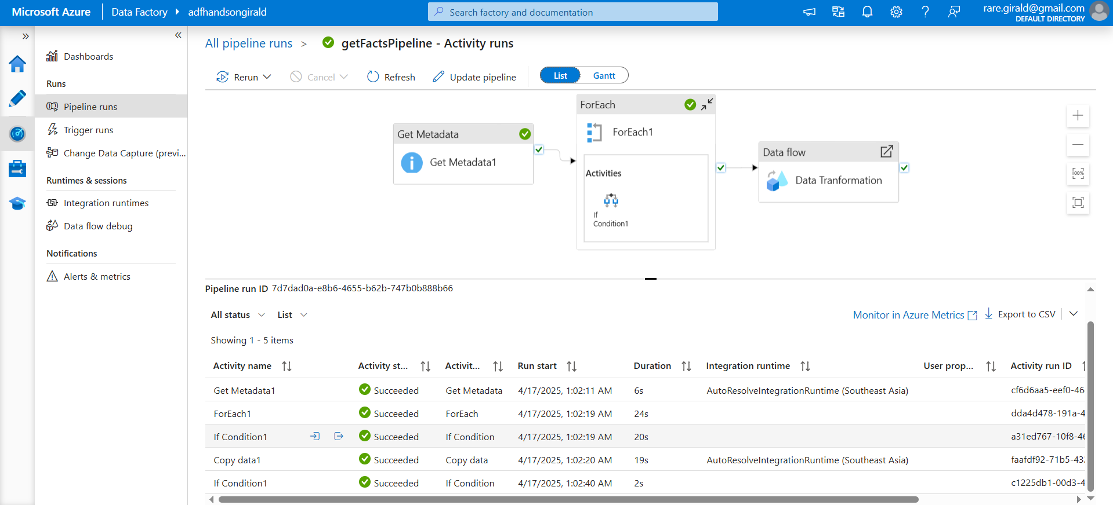
Creating a trigger for the pipeline

Slide 9
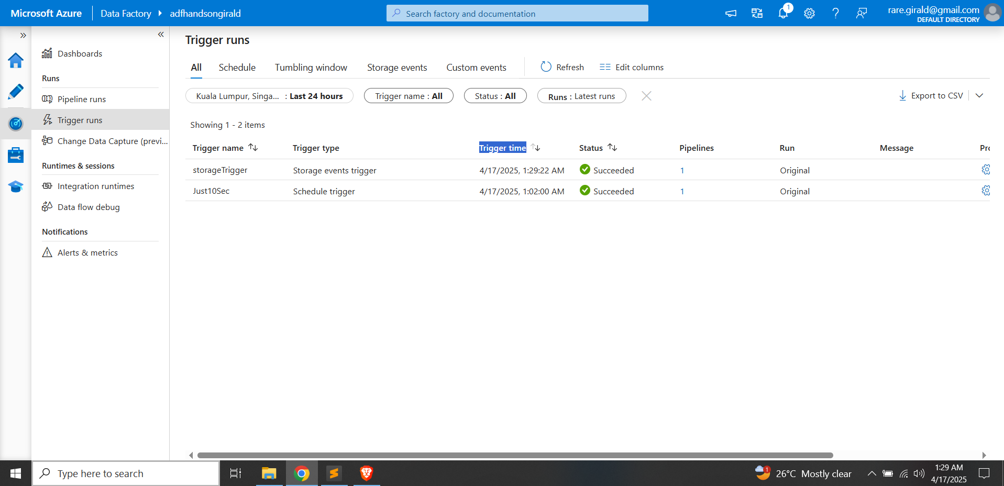
Creating a storage event for the pipeline

Slide 10
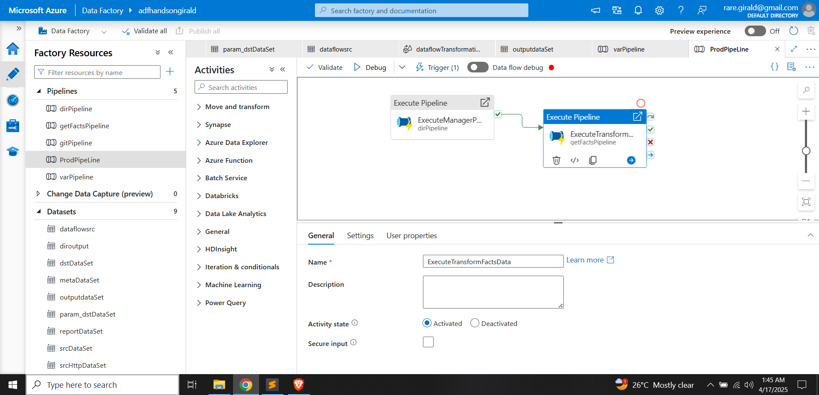
Trigger one pipeline after another using execute pipeline

Slide 11
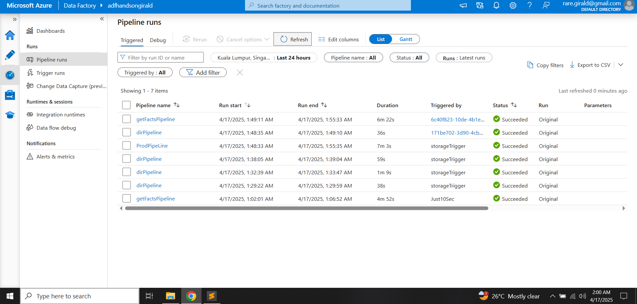
Monitoring running pipelines

Slide 12
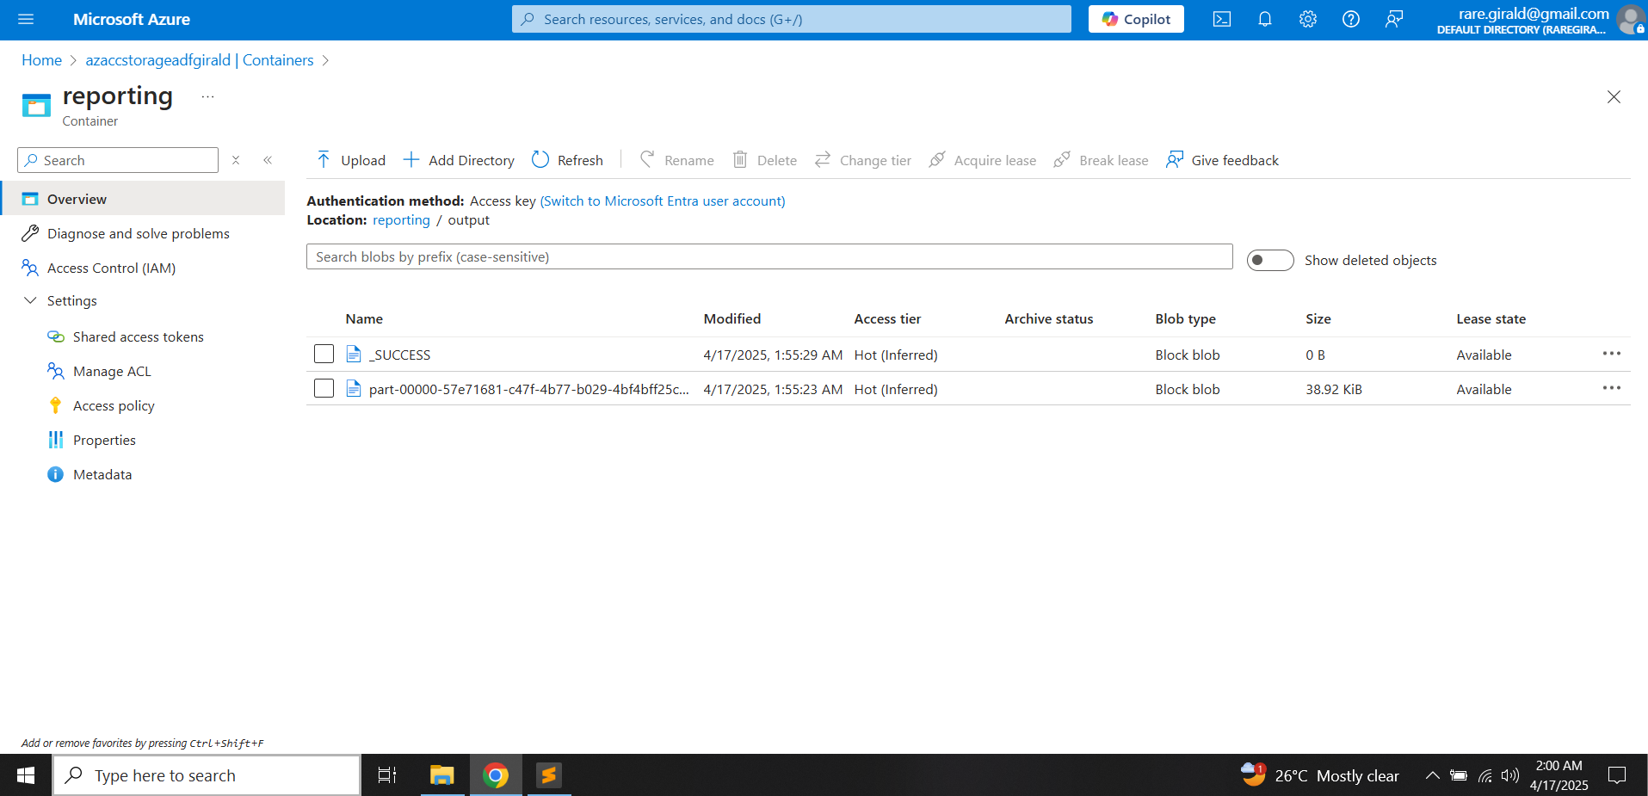
Result of data transformation in CSV file format

